Slide 1

Capstone Presentation
Abhijit Pawar

Slide 2
Capstone Goal
The objective of my capstone project was to create a credit risk model that will most accurately predict whether or not a borrower will default on a loan based on factors such as his/her age, income, years employed, credit history length, loan amount, and interest rate

Slide 3
Steps
Data Wrangling – Uploading and cleaning dataset
Exploratory Data Analysis – Assess trends and see distribution of columns
Pre-processing – creating dummy variable and scaling data
Modeling – Used 4 classification models and calculated the accuracy to find the most accurate one

Slide 4
Data
Link for Dataset : https://www.kaggle.com/datasets/laotse/credit-risk-dataset?select=credit_risk_dataset.csv
Data was obtained from the Kaggle site has 32587 observations and consisted of the following columns:
Age
Years Employed
Loan grade
Credit History
Default (Main Target (1 if Yes, 0 if no)
Interest Rate
Loan Amount
Loan intent
Home ownership type
Borrower defaulted before(Y/N)
Loan Amount(% Income)
Income

Slide 5
Data Wrangling

Slide 6
Data Wrangling Steps
These were the steps I took to clean the data:
Identified columns that had null values and replaced those null values with either mean or median depending on their distribution
Checked for other anomalies in the data to see what they are and filtered them out
Checked the data types of all the columns to see if they were the right type

Slide 7
Finding and Replacing Null Values
There were only two columns that had null values and they were the interest rate and years employed column
After looking at their distribution I saw that they were left skewed and decided to use their median values to replace the null values

Slide 8
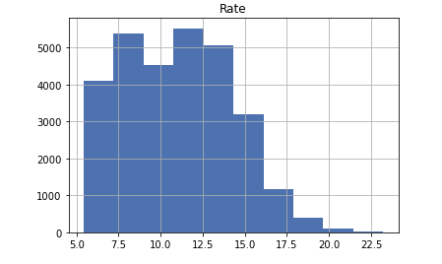
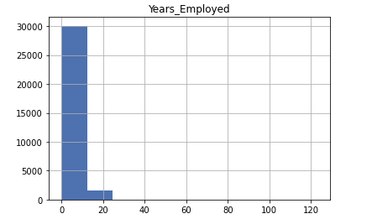

Slide 9
Data Anomalies
Other data anomalies I found were that some borrowers were more than 100 years old and some had more that 40 years of work experience.
These were data entry errors so I simply deleted them from the dataset

Slide 10
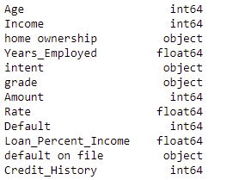
Data Types
There were no issues in the data types of columns as they were the exactly how they were supposed to be

Slide 11
Exploratory Data Analysis(EDA)

Slide 12
EDA Steps
For the EDA,
I looked at the relationship between the numeric columns namely rate, age, income, years employed, and credit history for both defaulters and non-defaulters
Looked at the distribution of the numeric columns to see how they were skewed
Breakdown by the object columns

Slide 13
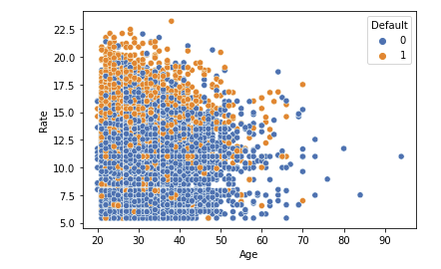
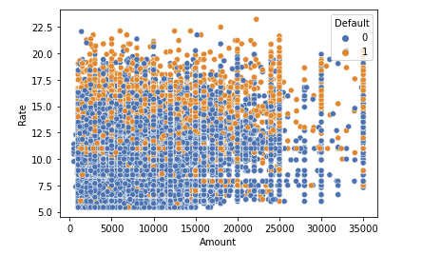
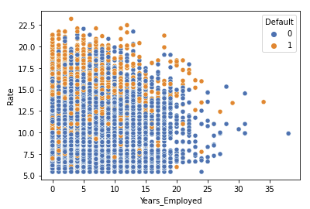
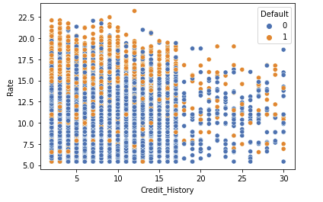
Trends

Slide 14
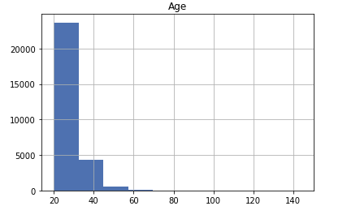
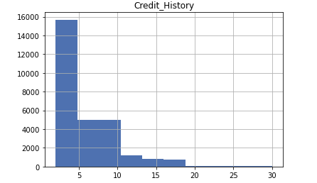
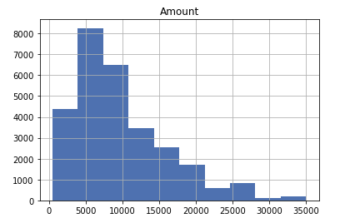
Data Distributions

Slide 15
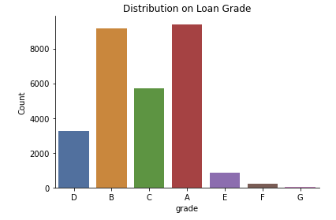
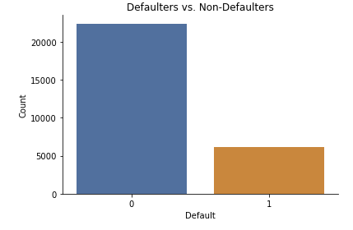
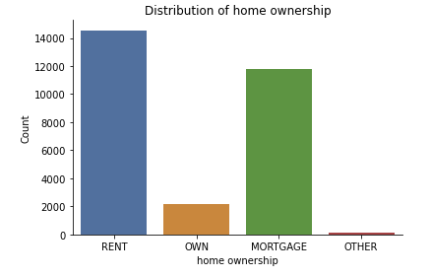
Bar Charts

Slide 16
Pre-processing

Slide 17
Steps
In order to pre-process the data I:
Created dummy variable columns from the object column from I ended up getting 27 columns
Created an X set which had just the features (dependent columns) and a Y set that had just the target variable, default
Did a 80%- 20% train test split on the data

Slide 18
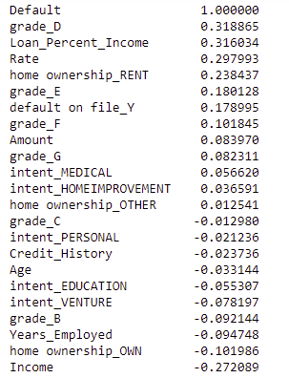
Spearman Correlation For Default

Slide 19
Modelling

Slide 20
Classification Models
Since the target variable is binary, I used four classification models:
Logistic Regression
K-Nearest Neighbor (kNN)
Decision Tree with both Gini and entropy
CatBoost
For each I calculated:
Training and test accuracy
Confusion Metric
Classification Report
ROC-AUC Curve
Feature Importance (only for Logistic Regression and CatBoost)

Slide 21
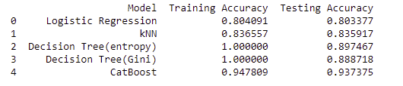
Accuracy

Slide 22
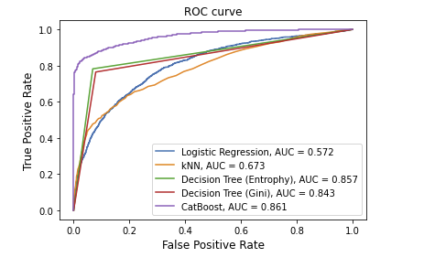
ROC-AUC Curves

Slide 23
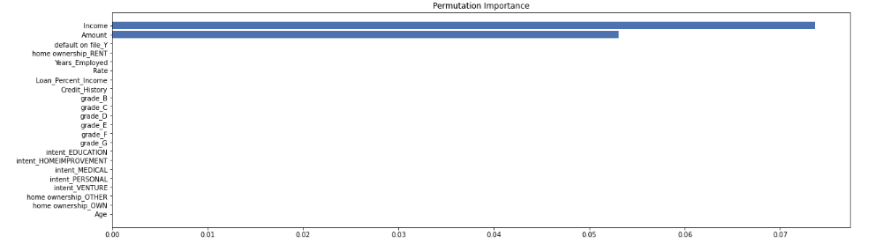
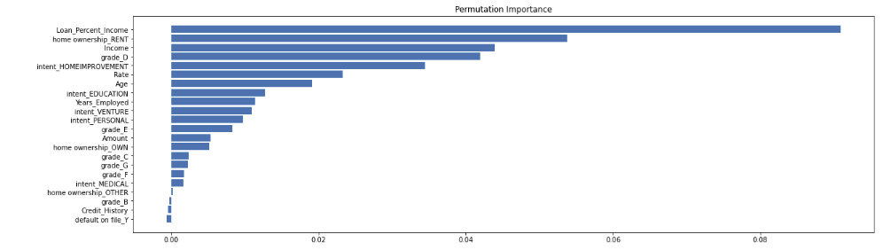
Feature Importance
Logistic Regression
CatBoost

Slide 24
Conclusions
The CatBoost model is the best model to use when it comes to predicting if a borrower will default or not, as it has the highest accuracy and ROC-AUC Score
Feature Importance:
In the Logistic Regression model Amount & Income are the only two important features which explains why the accuracy is low
In the CatBoost model there are many features that are important, which explains why the accuracy is high

Slide 25
Next Steps
After identifying the most accurate models, the next step will be create a program that will allow the user the to enter in information on a potential borrower that will generate a prediction if the borrower will default or not. Furthermore it will allow the user to increase or decrease some of the inputs such as loan amount and interest rate, to see which loan can be given to the borrower so that the borrower will not default.

